Slide 1

DevOps and CI/ CD - An Introduction
Programming Applications And Frameworks (It3030)

Slide 2
Learning outcomes
After completing this lecture, you will be able to,
Describe the failures in the traditional software deployment methods, and the reasons for the rise of DevOps.
Describe the main components of DevOps.
Describe what CI/ CD is and how its application is beneficial in modern software development.
Describe the importance of Test Automation in DevOps.
Apply the concepts learnt in solving real-world problems.

Slide 3
Contents
Deploying an app
Typical Deployment Scenario
Failures
DevOps
Core DevOps principles
Continuous Integration (CI)
Continuous Delivery and Continuous Deployment (CD)
Infrastructure Automation
Software Testing and Test Automation
Wrap Up
Summary

Slide 4
Journey so far
What was discussed so far,
Software Frameworks
Version controlling with Git
Git Workflows
Web application architectures
REST APIs
An overview on Frontend development

Slide 5
Deploying an app
We have discussed how we engineer a web application so far.
However, engineering the application is not enough.
It must be deployed!
Why? So that actual users can use the application.

Slide 6
Deploying an app
Application Deployment, also known as Software Deployment, is the process of installing, configuring, updating, and enabling one application or suite of applications that make a software system available for use. (Source)

Slide 7
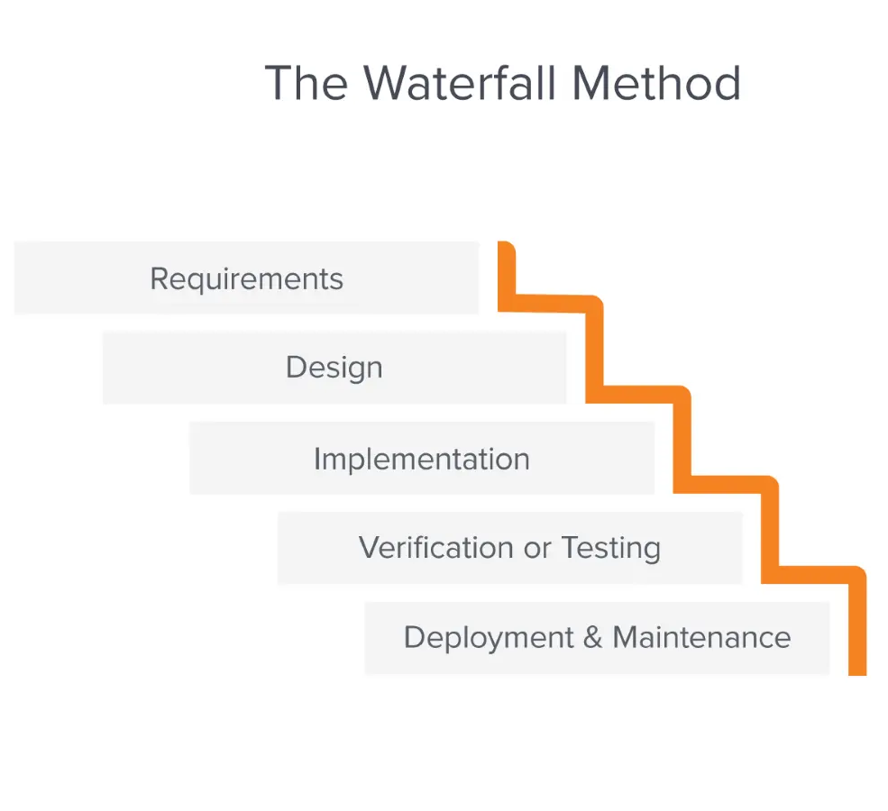
Typical Deployment Scenario
How were deployments handled traditionally?
Waterfall model was the most common SDLC model used back in the day.
SDLC - Software Development Life Cycle
In Waterfall model, each stage is carefully planned and executed sequentially by a dedicated team.
E.g.: Business stakeholders, Business Analysts, Architects, Developers, Quality Assurance, IT Operations
Source: https://business.adobe.com/blog/basics/waterfall
Notes:
SDLC = Software Development Life Cycle

Slide 8
Typical Deployment Scenario
A release would be carried out every few months.
First, the developers would develop the solution.
Then the QA team would start release testing the application leading to the release.

Slide 9
Typical Deployment Scenario
The QA team would then discover bugs.
QA team would frantically report the bugs.
Developers would frantically fix the bugs.
Now the QA team has to retest the fixes.
This is on top of the functionality remaining to be tested!
Typically, the developers and/ or QA teams would get overwhelmed with the workload as the release date becomes closer.

Slide 10
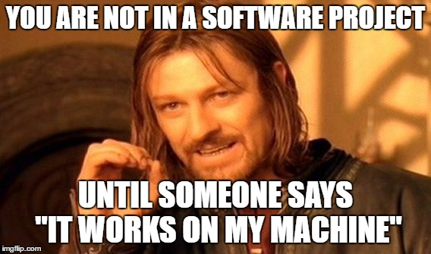
Typical Deployment Scenario
Then the Developers, QA and IT Operations teams would recommend to push ahead the release date given the problems.
Business stakeholders would not agree!
They dictate that release be carried out as planned as they have their own strategic goals to meet.
IT Ops would also run into various problems deploying the application.
Famous example: It works on my machine!
Source: https://elbruno.com/you-are-not-in-a-software-project-until-someone-says-it-works-on-my-machine/

Slide 11
Typical Deployment Scenario
Finally, the release would be carried out as planned even with the issues.
It will be rolled back in the next couple of hours after doing everything to make the application work fails.
Redeploy again with several components disabled.
Fixes will be carried out for some time after the release to stabilize the product.
The product is actually usable only after few days/ weeks after the release.
Rinse and repeat for the next release!

Slide 12

Typical Deployment Scenario: Failures
Each team (Dev/ QA/ IT Ops) worked separately and had competing objectives (“siloed”).
Each team had their own goals.
Resulted in botched releases and unhappy customers.
Lots of firefighting/ finger pointing - Very stressful environment!
Source: https://resources.biginterview.com/behavioral-interviews/behavioral-interview-questions-conflict/

Slide 13
DevOps
Somewhere between 2007-2009 different communities started raising concerns about the level of dysfunction in doing releases this manner.
There had to be a better way of doing things!
Gradually a movement appeared against the traditional mindset of keeping different stakeholders separated in different silos.
This is the origin of “DevOps”.
[YouTube] What is DevOps?

Slide 14
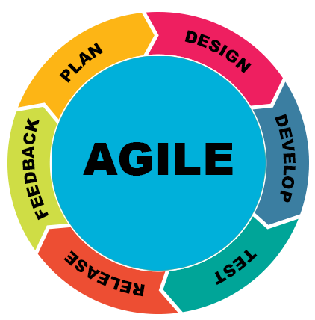
DevOps
DevOps stands for “Development-Operations”.
The concept behind DevOps is simple.
Bring the Developers, QA, IT Operations (IT Ops) teams together to work collaboratively on planning, building, testing and releasing software with shared responsibility for successful business outcomes.
Based on Agile approach to software development!
DevOps is not just a method for Software Development. It’s a culture.
Source: https://technology.berkeley.edu/tpo/agile
Notes:
DevOps represents a change in mindset for IT culture. In building on top of Agile and lean practices, DevOps focuses on incremental development and rapid delivery of software. Success relies on the ability to create a culture of accountability, improved collaboration, empathy, and joint responsibility for business outcomes.

Slide 15
DevOps
DevOps is a combination of software development (dev) and operations (ops). It is defined as a software engineering methodology which aims to integrate the work of development teams and operations teams by facilitating a culture of collaboration and shared responsibility. (Source)

Slide 16
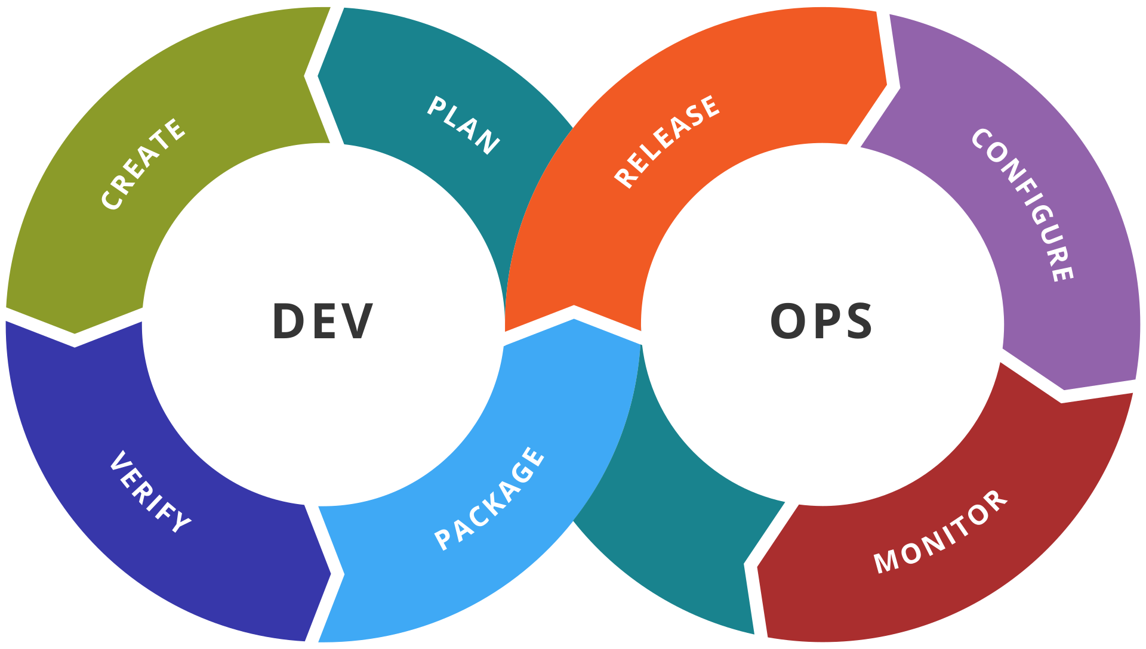
DevOps Stages
Source: https://en.wikipedia.org/wiki/DevOps_toolchain

Slide 17
Core Devops Principles
Automation of the software development lifecycle
Automating the SDLC as much as possible increases productivity by reducing the introduction of human errors and freeing up humans from repetitive tasks.
Mainly consists of,
Continuous Integration (CI)
Continuous Delivery and Continuous Deployment (CD)
Infrastructure Automation (Automated provisioning of Environments and other resources)
Test Automation - Shift Left Testing (Read this)

Slide 18
Core Devops Principles
Collaboration and communication
Developers, QA, stakeholders, IT Ops should communicate clearly to collaborate efficiently. At the end of the day, it is everyone’s responsibility to deliver software which satisfies business requirements.
Continuous improvement
It is the practice of focusing on experimentation, minimizing waste, and optimizing for speed, cost, and ease of delivery.
Customer-centric action
DevOps teams use short feedback loops with customers and end users to develop products and services centered around user needs.

Slide 19
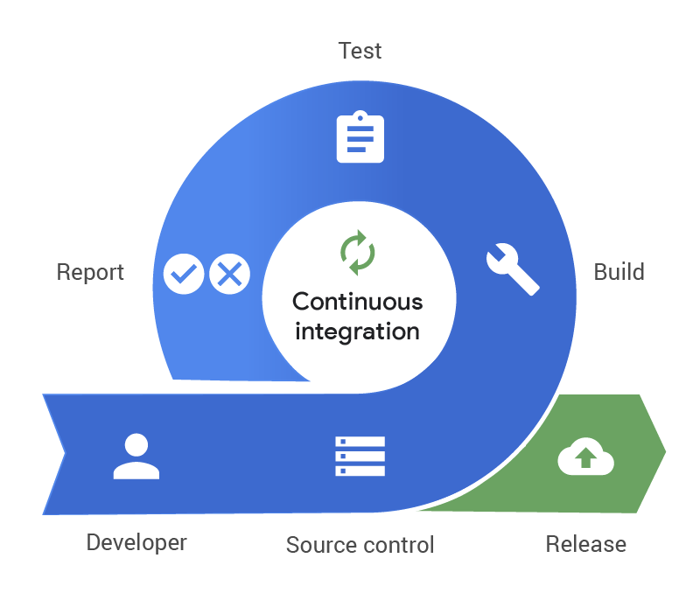
Continuous Integration (CI)
Continuous integration is the practice of,
Frequently pushing all code changes into a designated main branch of a code repository,
automatically kicking off a build whenever there is a new change(s),
And running automatic tests against the build to verify the change.
Developers need to create the tests too if they don’t exist already.
Source: https://www.pagerduty.com/resources/learn/what-is-continuous-integration/

Slide 20
Continuous Integration (CI)
By merging changes frequently and triggering automatic testing and validation processes,
the issues can be discovered early and fixed then and there.
Integration challenges that can happen when waiting for release day to merge changes into the release branch can be avoided.
Quality of the product can be verified from the early days of development rather than near the release date (Shift-left testing).

Slide 21
Continuous Delivery (CD)
Continuous delivery is an extension of continuous integration.
It is the deployment of all built and automatically tested deliverables (basically executables) to a further testing and/or production environment after the CI stage via an automated process.
This takes away the stress on a team to prepare for a delivery for days.

Slide 22
Continuous Delivery (CD)
This deployment process is triggered manually. Once the process is triggered, the deployment happens automatically.
The user has the control over when the automatic deployment should be triggered with just a click of a button.
Feature flags are used to disable/ hide incomplete features from affecting customers in production.

Slide 23
Continuous Deployment (CD)
Continuous Deployment is a further extension of Continuous Delivery.
With Continuous Deployment, every change that passes all stages of the production pipeline is released to the customers.
There is no human intervention, and only a failed test will prevent a new change to be deployed to production.
Feature flags are an inherent part in Continuous Deployments.

Slide 24
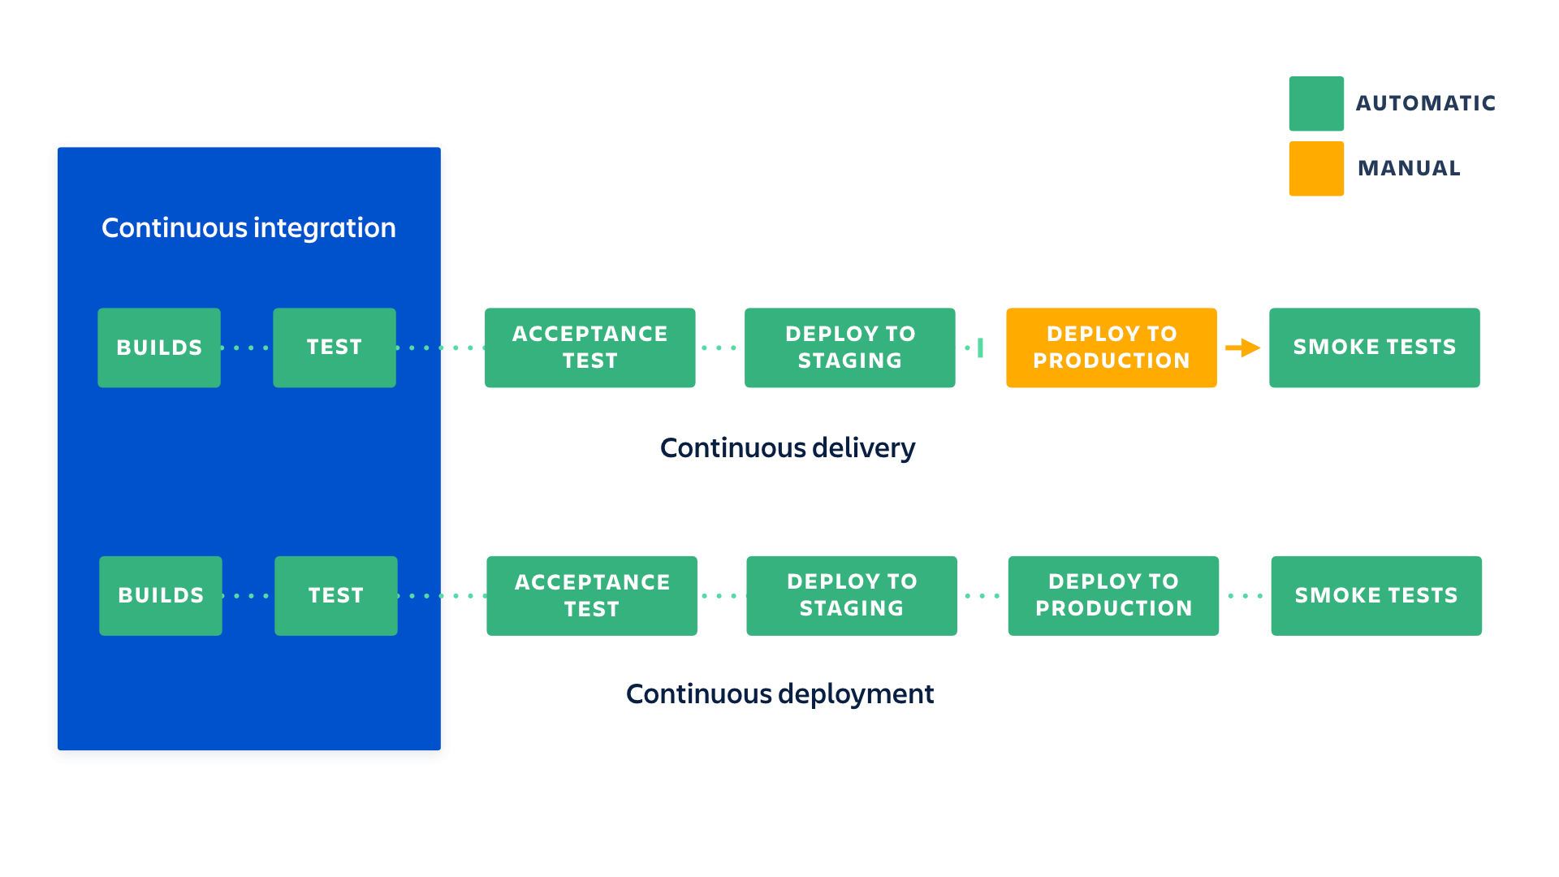
Continuous Integration and Continuous Delivery vs. Continuous Deployment
Source: https://www.atlassian.com/continuous-delivery/principles/continuous-integration-vs-delivery-vs-deployment

Slide 25
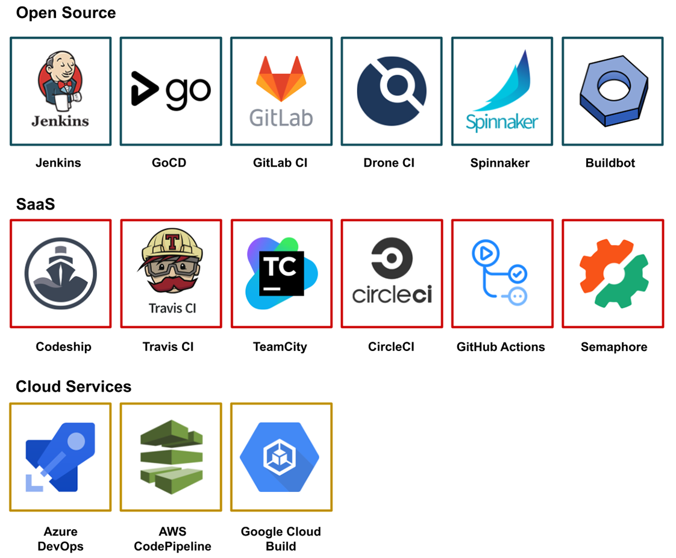
Some popular Tools for Ci/ CD
Source: https://livebook.manning.com/book/pipeline-as-code/chapter-1/135

Slide 26
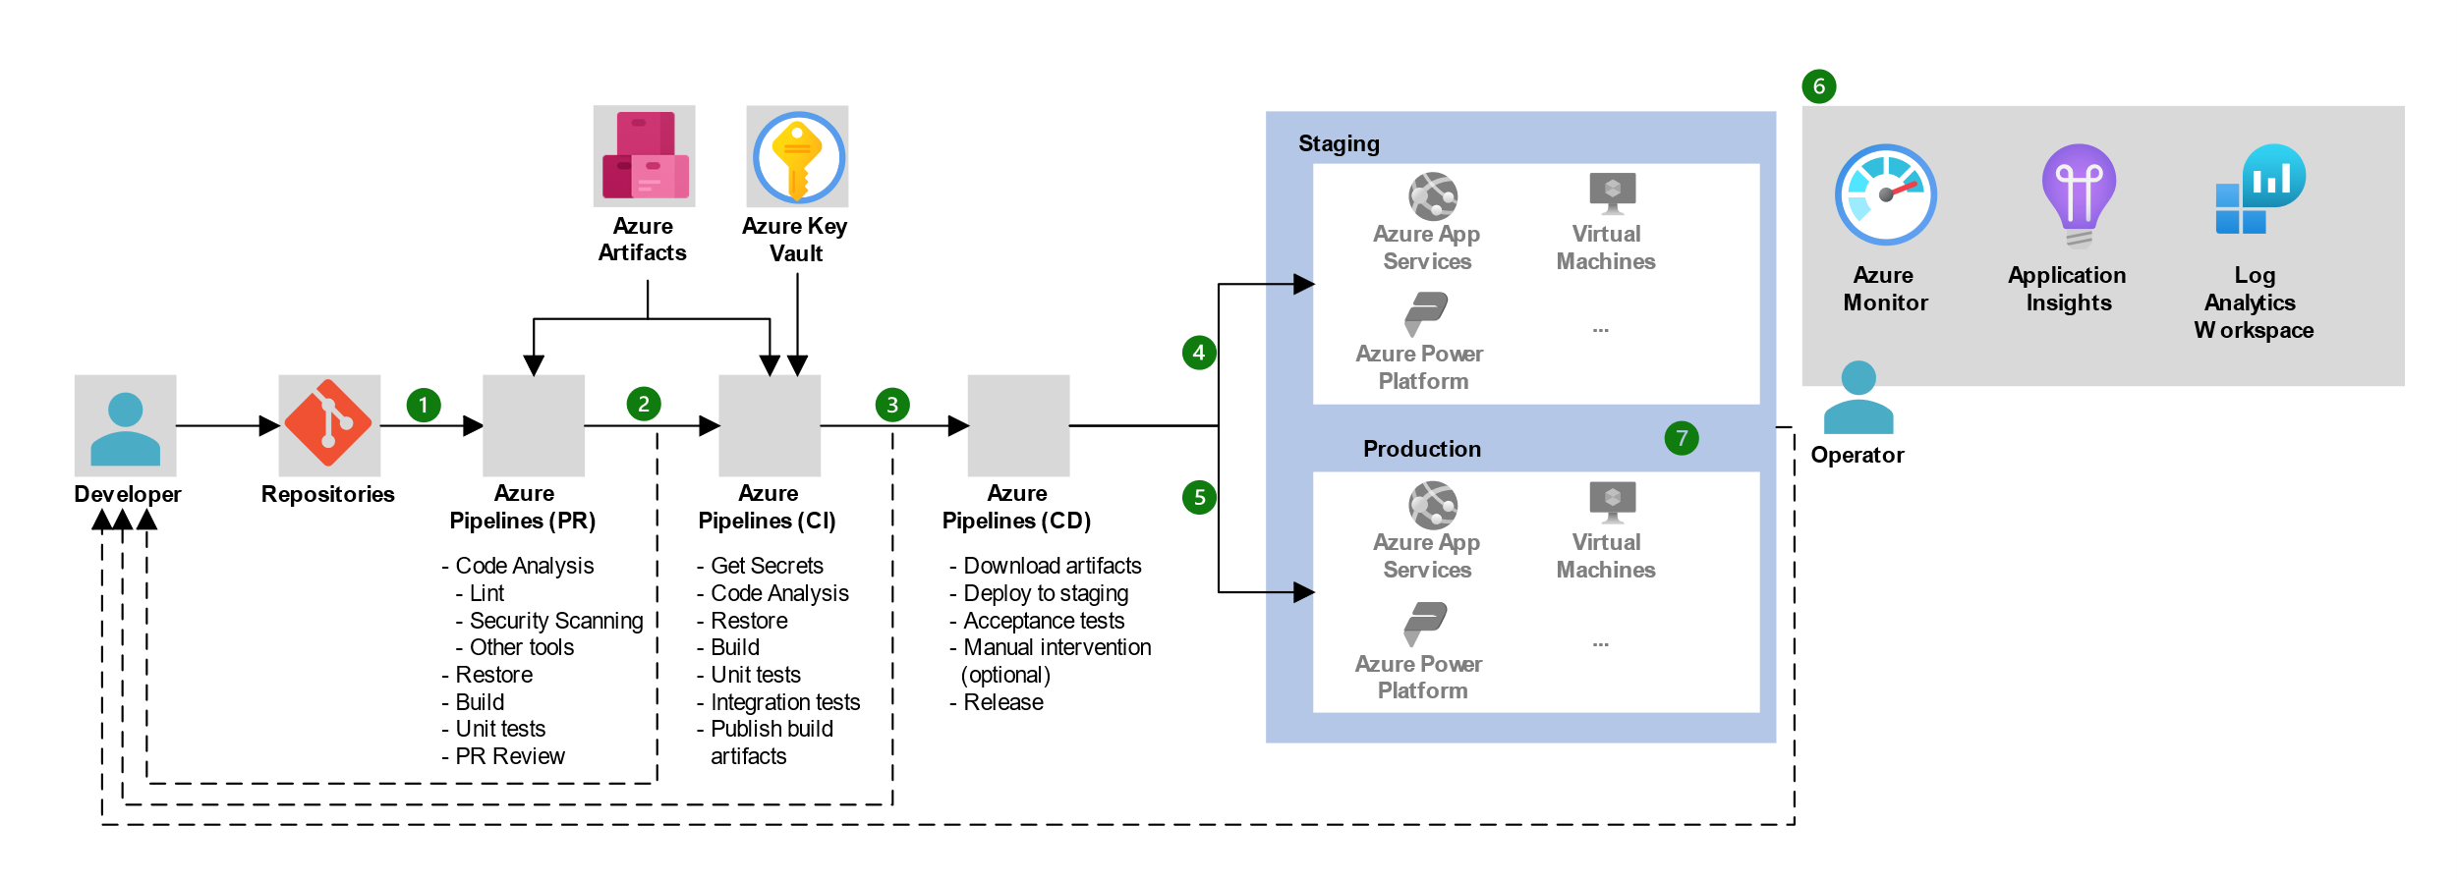
Example CI/ CD Workflow on Azure Devops
Source: https://learn.microsoft.com/en-us/azure/architecture/example-scenario/apps/devops-dotnet-baseline

Slide 27
Benefits of Continuous Integration
Less bugs get shipped to production as regressions are captured early by the automated tests.
Building the release is easy as all integration issues have been solved early.
Less context switching as developers are alerted as soon as they break the build and can work on fixing it before they move to another task.
Testing costs are reduced drastically – your CI server can run hundreds of tests in the matter of seconds.
Your QA team spends less time testing and can focus on significant improvements to the quality culture.

Slide 28
Benefits of Continuous delivery
The complexity of deploying software has been taken away. Your team doesn't have to spend days preparing for a release anymore.
You can release more often, thus accelerating the feedback loop with your customers.

Slide 29
Benefits of continuous deployment
Deployments pipelines are triggered automatically for every change.
Releases are less risky and easier to fix in case of problem as you deploy small batches of changes.
Customers see a continuous stream of improvements, and quality increases every day, instead of every month, quarter or year.

Slide 30
CI/ CD Best Practices
Self-study activity: Read on best practices here.

Slide 31
Infrastructure Automation
Infrastructure automation refers to the practice of using software and tools to automate the provisioning, configuration, management, and operation of IT infrastructure.
It involves automating various tasks that would traditionally be performed manually, reducing the need for human intervention and increasing efficiency and reliability.
[YouTube] Infrastructure Automation with Red Hat Ansible
Notes:
Infrastructure automation is typically achieved using various automation tools, including configuration management tools (e.g., Ansible, Puppet, Chef), infrastructure as code tools (e.g., Terraform, CloudFormation), container orchestration platforms (e.g., Kubernetes, Docker Swarm), continuous integration/continuous deployment (CI/CD) pipelines, and monitoring and logging solutions.

Slide 32
Software Testing
Software testing can be broadly categorized into two types.
Functional tests – verifies if functional requirements are met
Non-functional tests – verifies if non-functional requirements are met

Slide 33
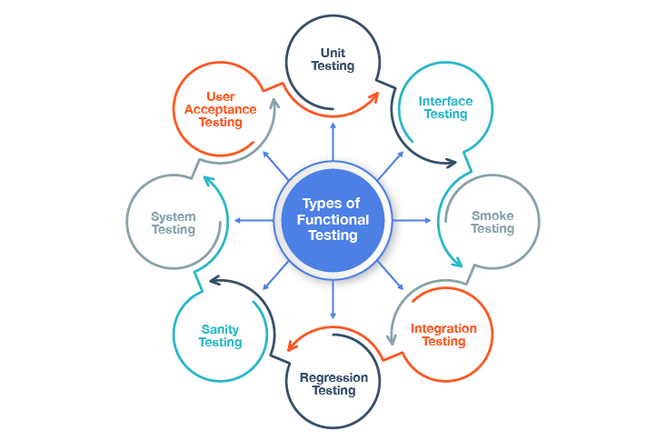
Functional Test Types
Source: https://testsigma.com/blog/the-different-software-testing-types-explained/

Slide 34
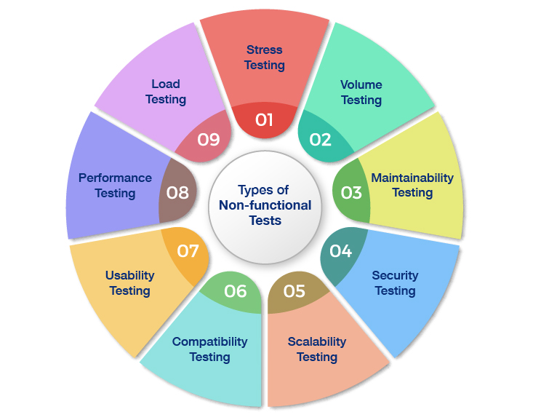
Non-Functional Test Types
Source: https://testsigma.com/blog/the-different-software-testing-types-explained/

Slide 35
Test Automation
In continuous testing, various types of tests are performed within the CI/CD pipeline. These can include:
Unit testing, which checks that individual units of code work as expected.
Integration testing, which verifies how different modules or services within an application work together.
Regression testing, which is performed after a bug is fixed to ensure that specific bug won't occur again.
Self study activity: Read this article on Automated software testing.

Slide 36
Wrap up
[YouTube] DevOps CI/CD Explained in 100 Seconds
Try out GitHub Actions: a CI/ CD Platform on GitHub.

Slide 37
Summary
Deploying an app
Typical Deployment Scenario
Failures
DevOps
Core DevOps principles
Continuous Integration (CI)
Continuous Delivery and Continuous Deployment (CD)
Infrastructure Automation
Software Testing and Test Automation

Slide 38
References
What is CI/CD?
4 Must-know DevOps principles
Manifesto for Agile Software Development
How Is Netflix SO GOOD at DevOps?
What Is Shift Left Testing?
Continuous integration vs. delivery vs. deployment
The different types of software testing

Slide 39

Thank You
Vishan.j@sliit.lk
nelum.a@sliit.lk

